Slide 1
Adapter Design Pattern
Name: Stefan Humpelstetter
Date:15.11.2017

Slide 2
Content
Issue
Usage
Example
Exercise
Sources

Slide 3
Issue
reuse an already existing component which has a different „view of world“
translate an interface into another one

Slide 4
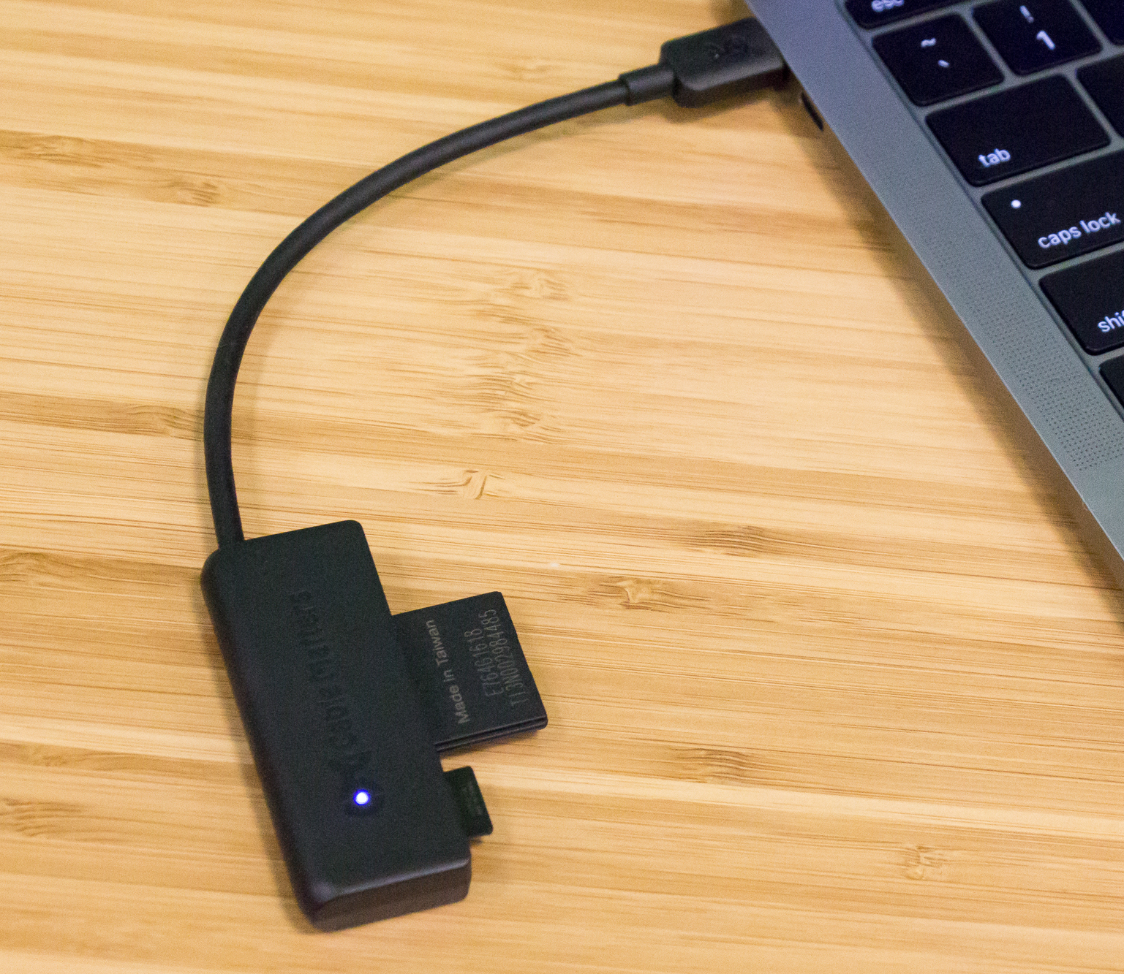
Usage
Like a bridge between two incompatible interfaces
The card reader translates as an adapter the card for the laptop

Slide 5
Differenation from other Patterns

Slide 6
Bridge Pattern
Adapter makes things work after they're designed; Bridge makes them work before they are

Slide 7
Facade Pattern
The Facade Pattern is just to simplify a user interaction with an interface, the Adapter Pattern handles complex interactions by reconstructing incoming data for the underlying objects

Slide 8
Example

Slide 9
an Audio Player which can play mp3 files only wants to use an advanced audio player which can play vlc and mp4 files

Slide 10
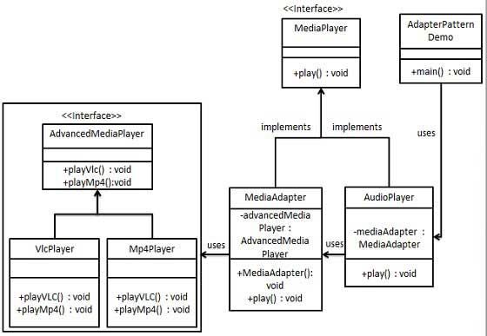

Slide 11



Slide 12
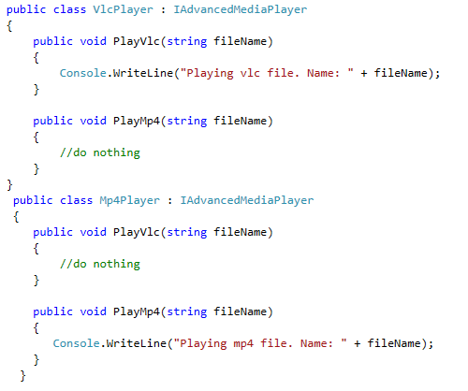

Slide 13
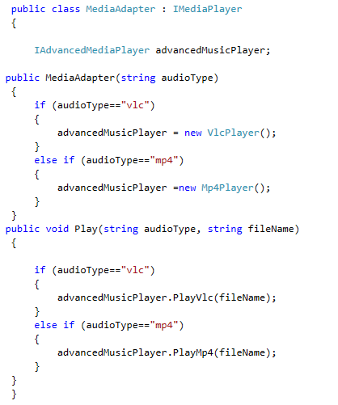

Slide 14
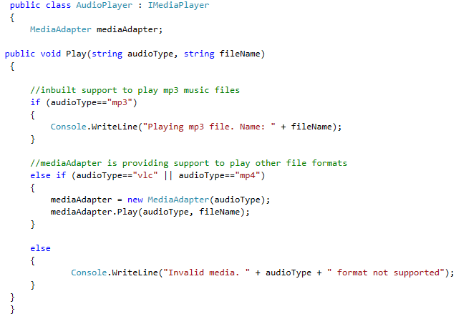

Slide 15
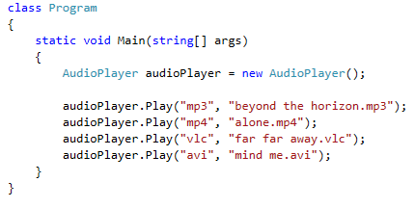
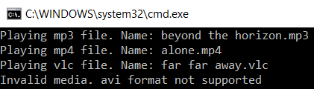
Test

Slide 16
Excercise

Slide 17
Create an even more advanced media player which can play mp5 and vlx format files
Use a new Adapter called AdvancedMediaAdapter
Let the already existing audio player play mp5 and vlx format files

Slide 18
Sources
https://sourcemaking.com/design_patterns/adapter
https://www.tutorialspoint.com/design_pattern/adapter_pattern.htm
https://de.wikipedia.org/wiki/Adapter_(Entwurfsmuster)

